Slide 1


Java EE
(ADVANCE JAVA)
Lecture-1

Slide 2
Today’s Agenda
What Is JEE ?
For What Applications We Use JEE ?
Working/Flow Of A JEE Application
How It Is Different Than JSE ?

Slide 3
What Is JEE ?
JEE stands for Java Enterprise Edition
It is a specification given by SUN for developing highly secure and scalable enterprise/web applications.
In simple words it is a platform developed by SUN for allowing programmers to develop applications that run on the server

Slide 4
What Is A Web Application ?
A web application which we usually refer to as website , is a collection of web pages .
In technical terms , A Web application (Web app) is an application program that is stored on a remote server and delivered over the Internet through a browser interface.

Slide 5
What Is A Web Application ?
It is a multi-tiered application, which means that functionality of the application is separated into different layers called as tiers
Typically, multi-tiered applications have a client tier, a middle tier, and a data tier (often called the enterprise information systems tier).

Slide 6
What Is A Web Application ?
The client tier consists of a client program that makes requests to the middle tier.
The middle tier's business functions handle client requests and process application data, storing it in a permanent datastore in the data tier.
The data tier represents the data storage area of the application and is mainly managed by RDBMS like Oracle,MySQL etc

Slide 7
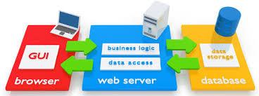
What Is A Web Application ?

Slide 8
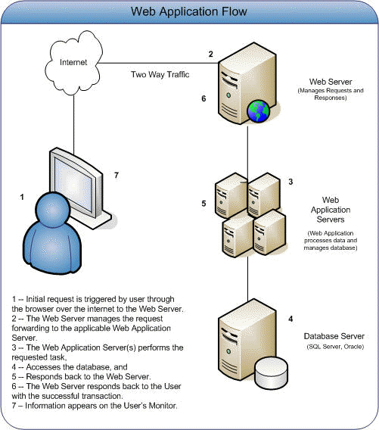
How A Web Application Flows ?

Slide 9
Web Application V/s Desktop Applications
Desktop Applications | Web Applications
Single User, One Location | Multiple Users, One Location
Data Is Stored Locally | Data Is Stored On The Cloud
Patch / Update has to be installed individually on every machine | Patch / update needs to be installed only on the server
Requires high end computers with special s/w and h/w to run | Since they are accessed using browser , a low end PC will also work

Slide 10
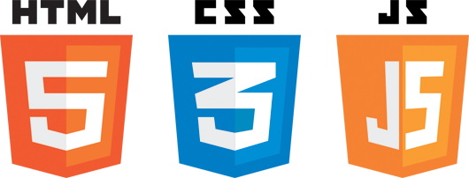
How the Client Tier Is Designed ?

Slide 11
How the Client Tier Is Designed ?
HTML (Hypertext Markup Language), CSS (Cascading Style Sheets) and JavaScript are essential components to your website.
They are as important to our website as sugar is to a cake.
We just can’t build a modern website without these components, and a web developer must be an expert in all three.

Slide 12
How the Client Tier Is Designed ?
HTML is a language that makes up the content of our website and tells our browser (like Internet Explorer or Google Chrome) what to show on the website.
CSS is a language used to describe the presentation (the look and formatting) of our website, and it tells our browser what to show on our website.
JavaScript is a programming language commonly used to create interactive effects within web browsers.

Slide 13
How the Client Tier Is Designed ?
In short we can remember that:
HTML is for content
CSS is for presentation
JavaScript is for behaviour

Slide 14
Why are they called Client Side ?
These are client-side technologies because when we go to a website, our browser downloads HTML, CSS and JavaScript.
At that point our browser renders (or processes) HTML and CSS and executes (or runs) JavaScript.
This happens on our computer; therefore, these technologies are client-side.

Slide 15
JSE V/s JEE
When most people think of the Java programming language, they think of the Java SE API which is popularly called CORE JAVA.
The Java SE's API provides the core functionality of the Java programming language. It defines everything like:
The basic data types and control statements
The concepts of OOPs
High-level classes that are used for networking, database access, graphical user interface (GUI) development etc

Slide 16
JSE V/s JEE
JEE is the super-set of Java SE, meaning it has all the features of Java SE.
It is the Enterprise Edition, which basically means that it has all the features that are specifically added for the development of giant Enterprise applications.
An important point to understand about Java EE is that it doesn’t has any compiler of it’s own. So it is the same JDK compiler using which we compile a Java EE application.

Slide 17
JSE V/s JEE
However to run a Java EE application we need Java EE compatible servers like GlassFish, JBoss, WildFly, Apache Tomcat etc.,
So Java EE is more of a "platform" than simple tools.

Slide 18
What We Should Know ?
To start learning JEE , we must be familiar with:
Basics of OOPs like Inheritance, Polymorphism etc
Polymorphism , specially interfaces and abstract classes
Exception Handling
No Applet,Swing or any other GUI like AWT is required.
No Threading is required
No File Handling is required

Slide 19
What We Will Learn ?
You will learn all 3 tiers :
Finally all this will be incorporated in a FREE PROJECT
Client Tier | Business Tier | Data Tier
HTML | Servlets | JDBC
CSS | JSP | Advance JDBC
JavaScript | Session Management | Design Pattern
Jquery | Java Beans | DAO Pattern
Ajax | EL | MVC Pattern
 | Custom Tags

Slide 20
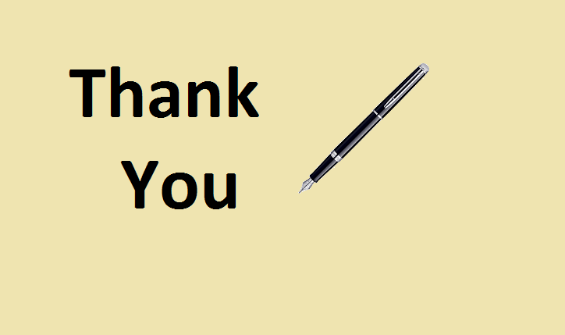
End Of Lecture
For any queries mail us @: scalive4u@gmail.com
Call us @ : 0755-4271659, 7879165533
Agenda for Next Lecture:
JDBC
JDBC Drivers
Steps Required for JDBC
References: www.ladenterprizes.com, www.intechnic.com

